Slide 1
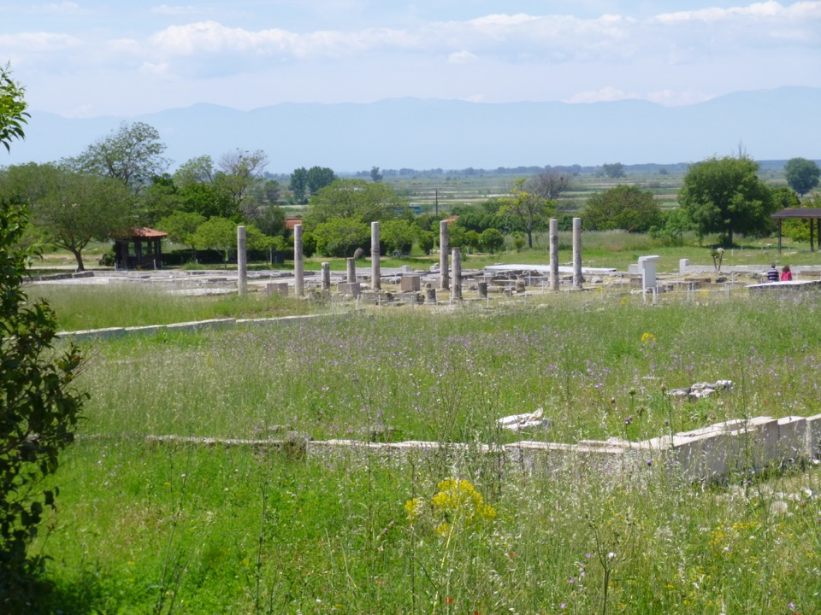
Pella
Alexander the Great’s hometown

Slide 2
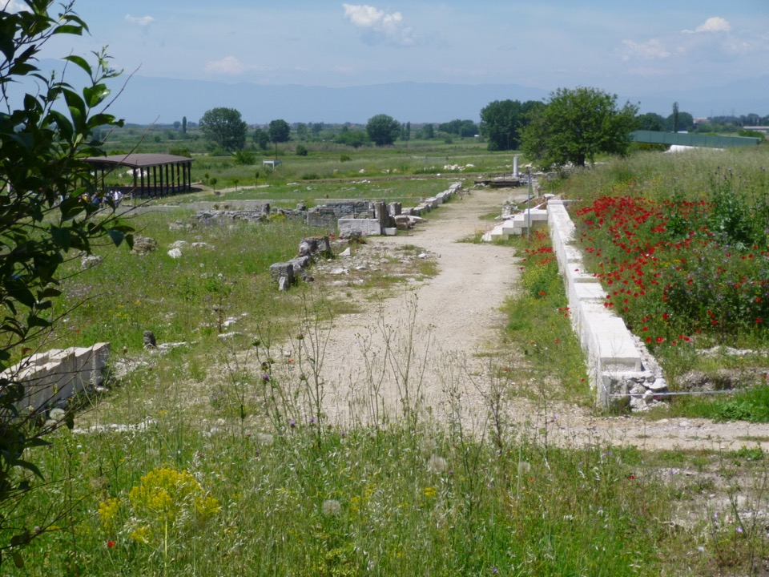
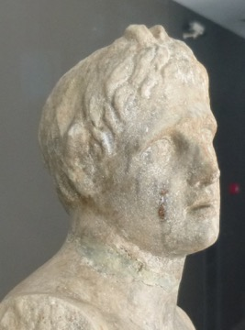
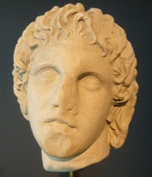
Alexander as Pan
with 2 small horns
the goat-footed god

Slide 3
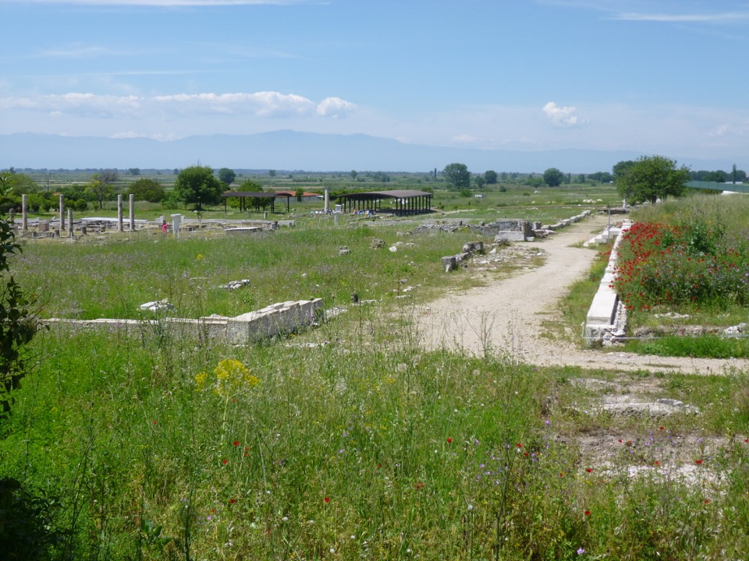

Slide 4
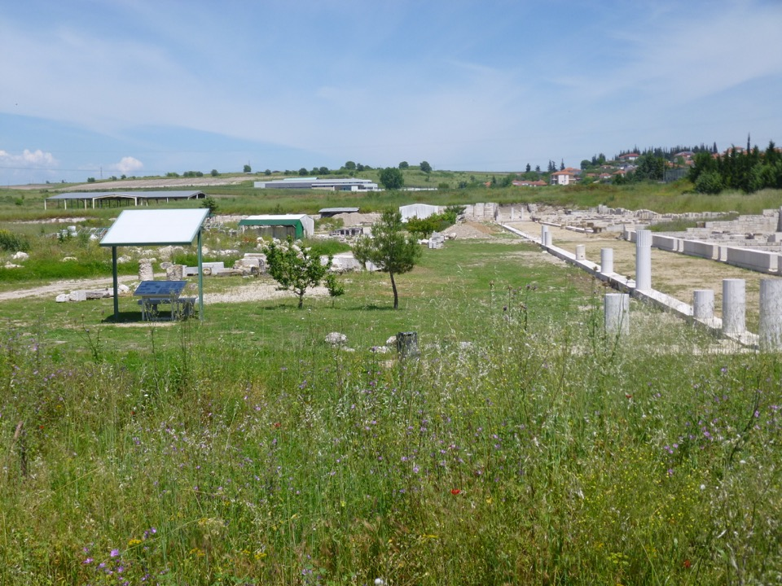

Slide 5
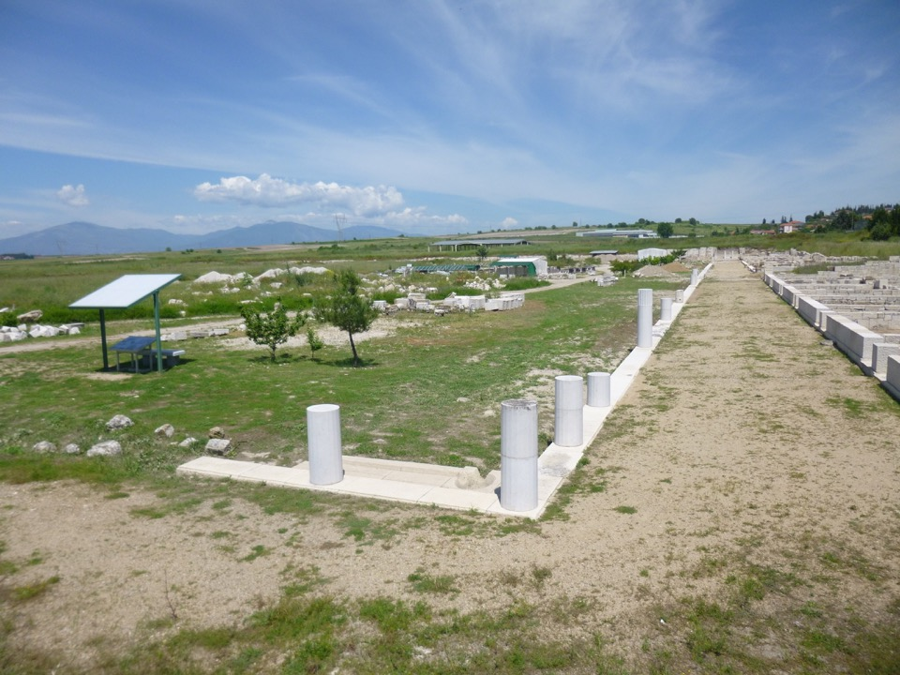

Slide 6
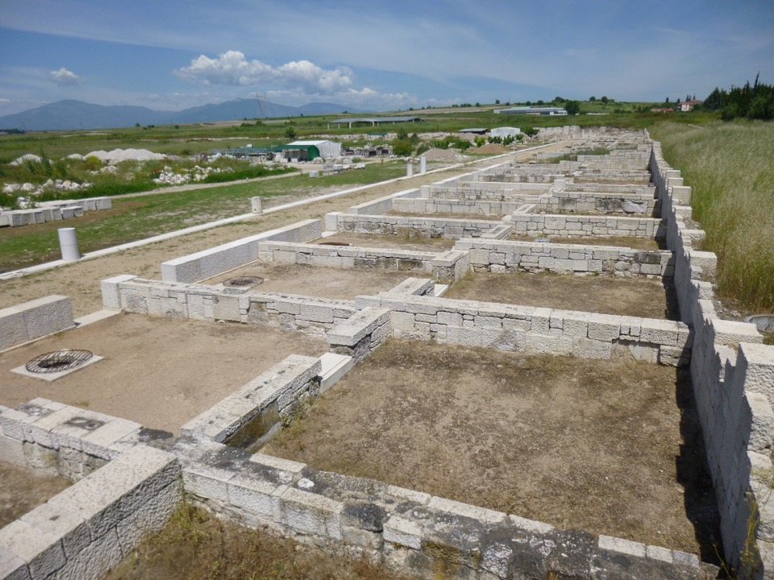

Slide 7
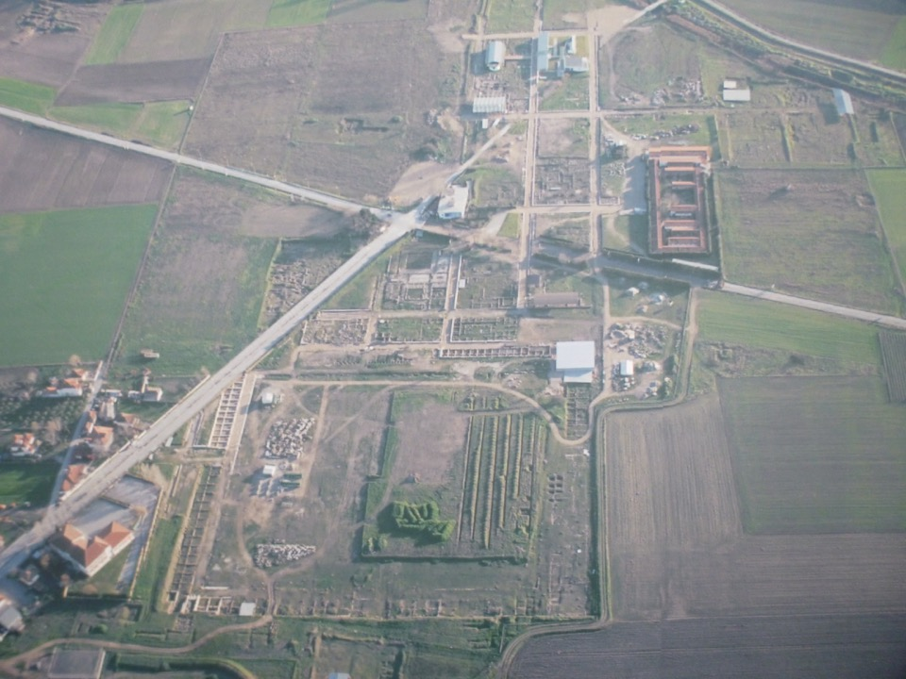
Excavations across modern village

Slide 8
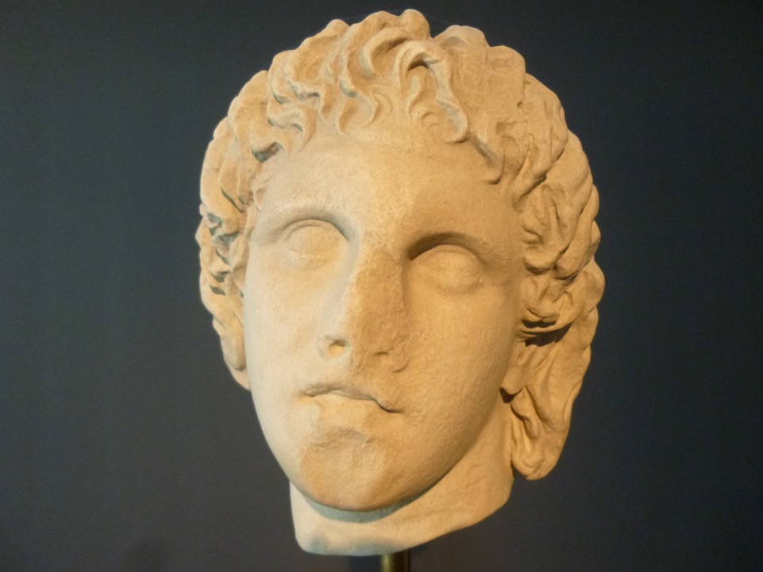
Alexander the Great (325-300 BC) –
marble head from
area of Giannitsa
Notes:
Marble head of Alexander the Great (325-300 BC) – from area of Giannitsa

Slide 9
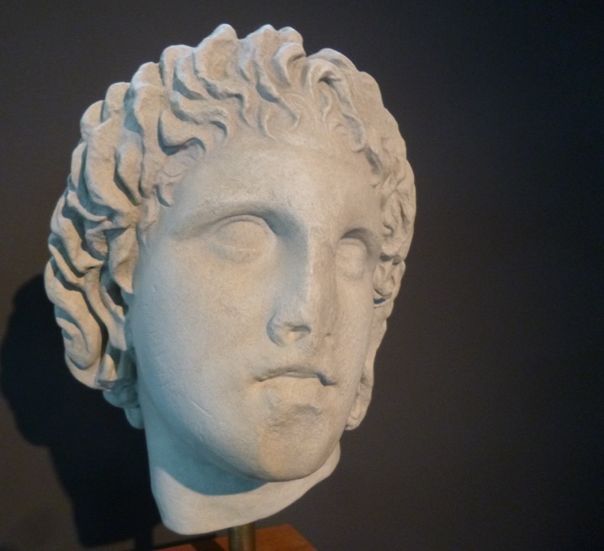
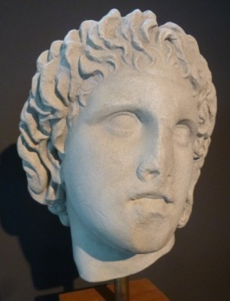
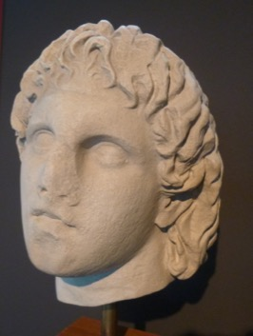

Slide 10
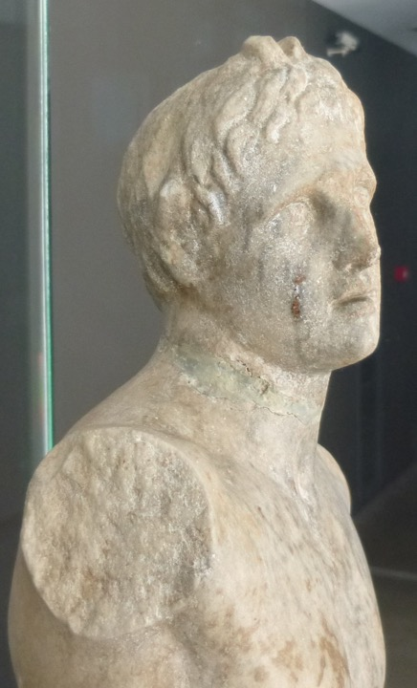
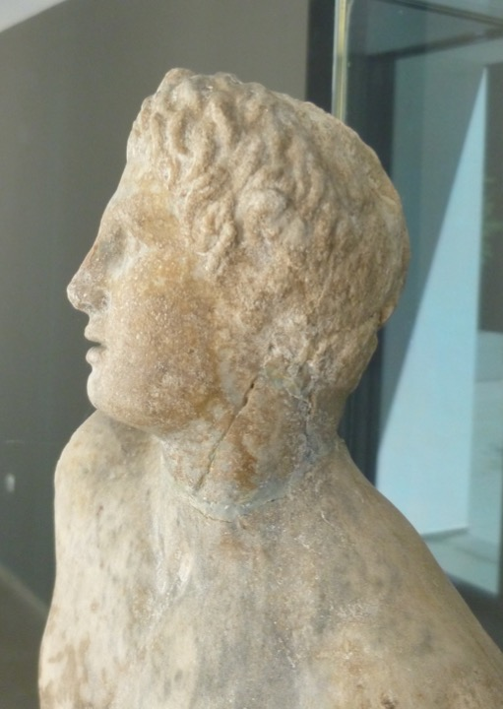
Alexander depicted as Pan with two small horns – representing the goat-footed god at Pella
(late 4th – early 3rd c. BC)
Notes:
Marble statuette of Alexander depicted as Pan with two small horns – confirms the cult of the goat-footed god at Pella. Late 4th – early 3rd c. BC.

Slide 11
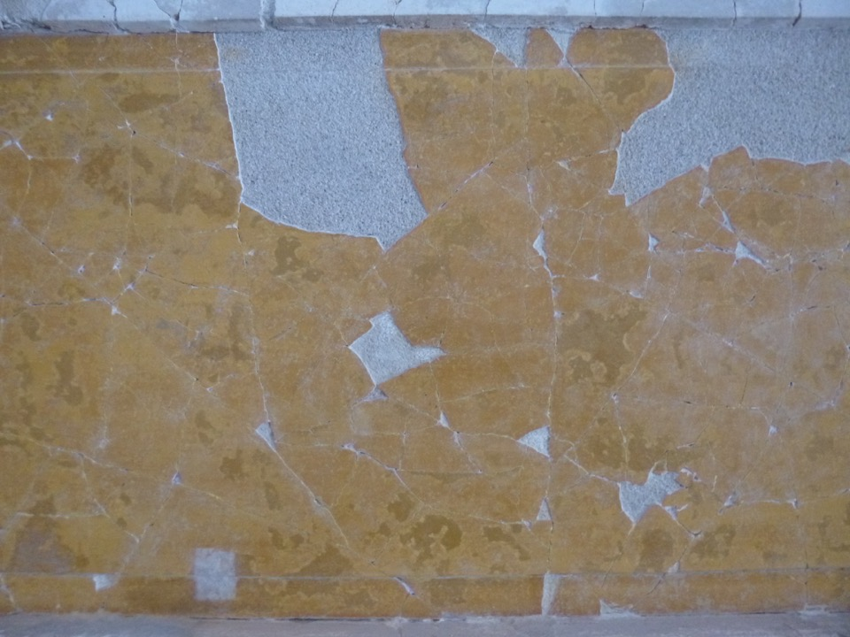
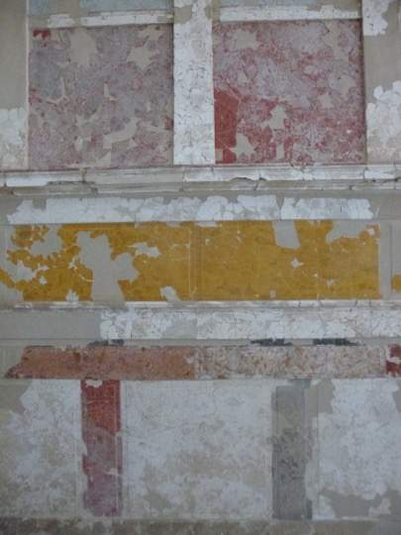
Pella
Museum

Slide 12
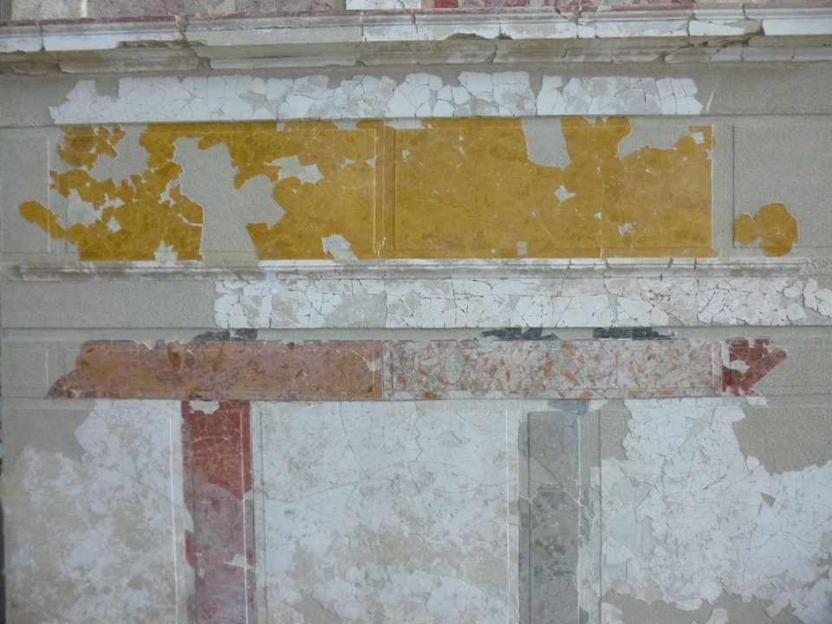
Luxurious homes from 3rd c. BC

Slide 13
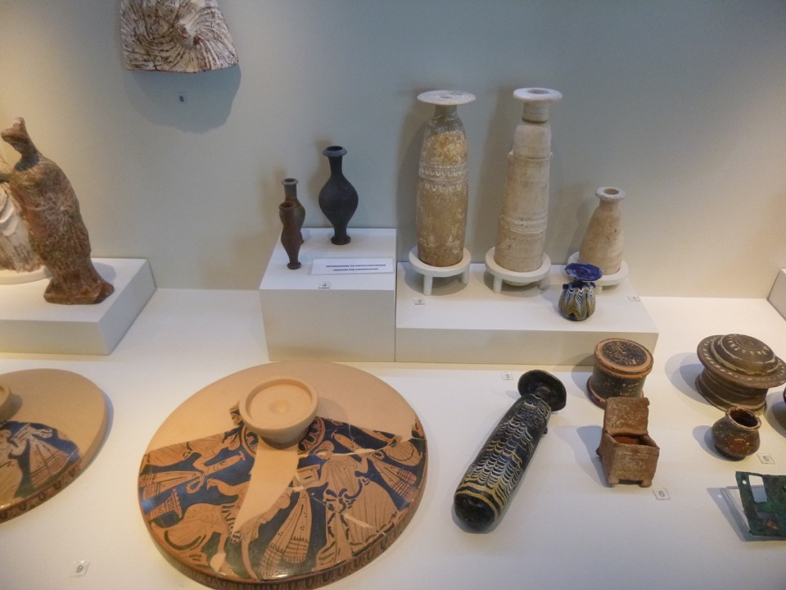
Items from private houses

Slide 14
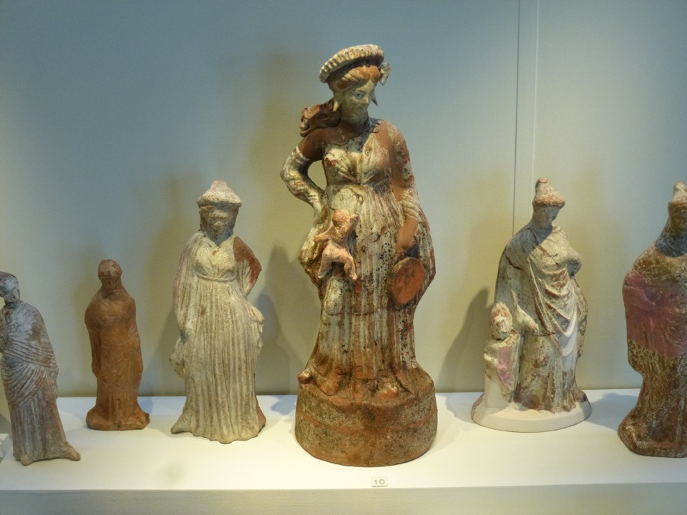
World of women

Slide 15
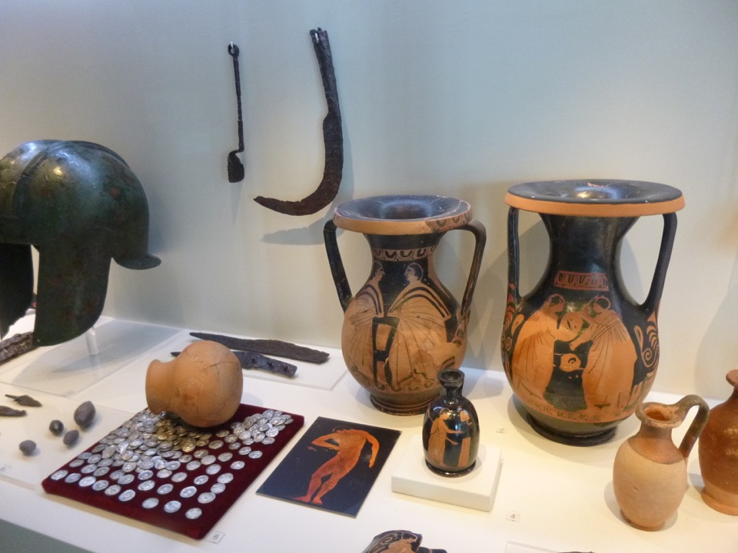
World of men

Slide 16
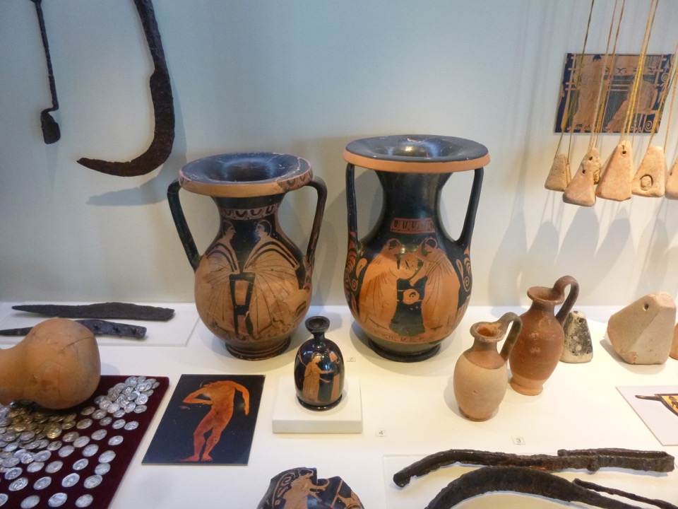
World of men

Slide 17
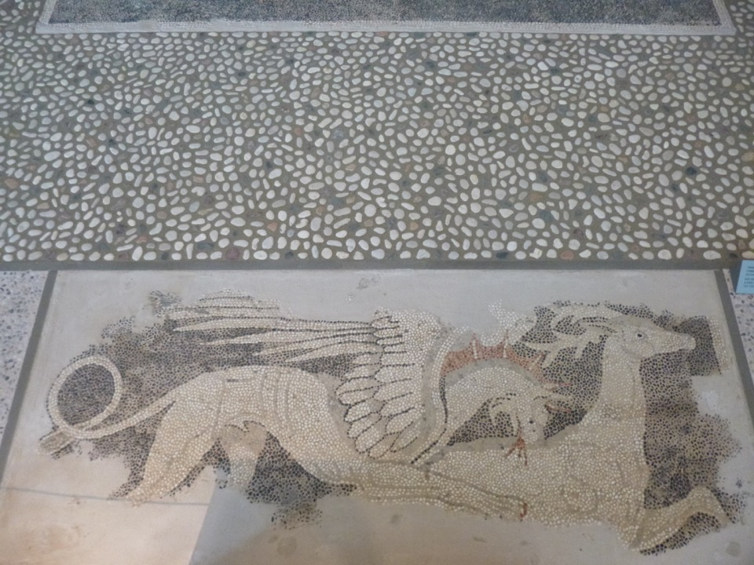
Dionysios on a panther and griffen tearing apart a deer
(from a house 325-300 BC)

Slide 18
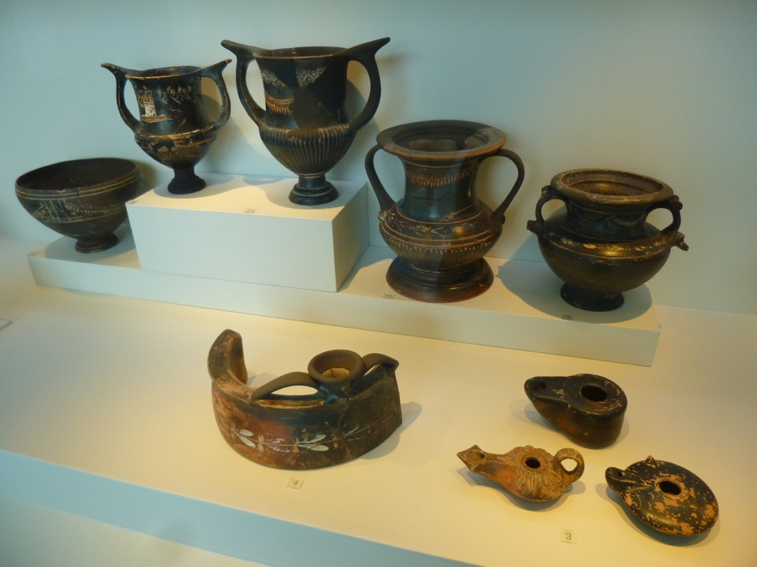
Banqueting vessels of the Hellenistic age
(3rd c BC)

Slide 19
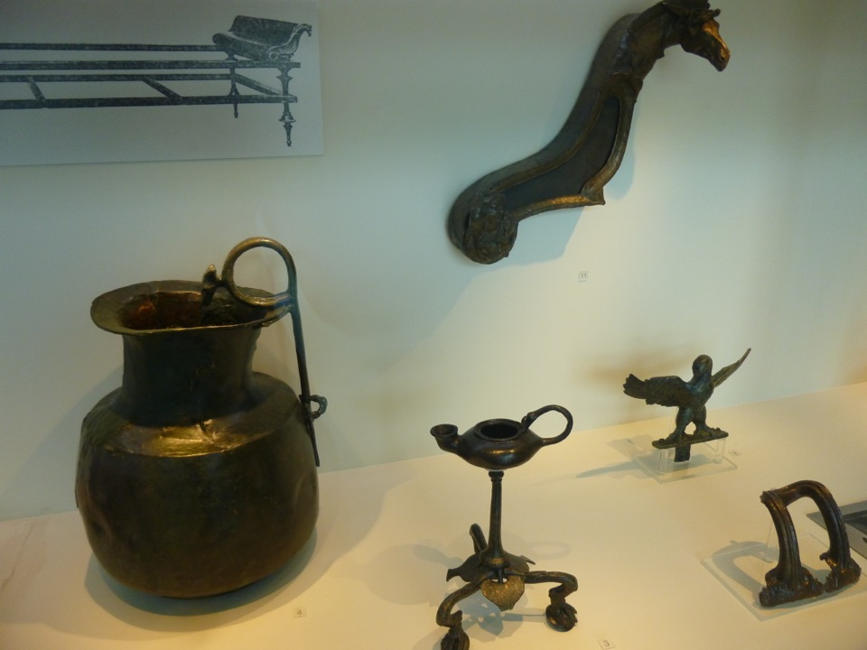
Bronze banqueting vessels of the Hellenistic age
(late 4th – early 1st c BC)

Slide 20
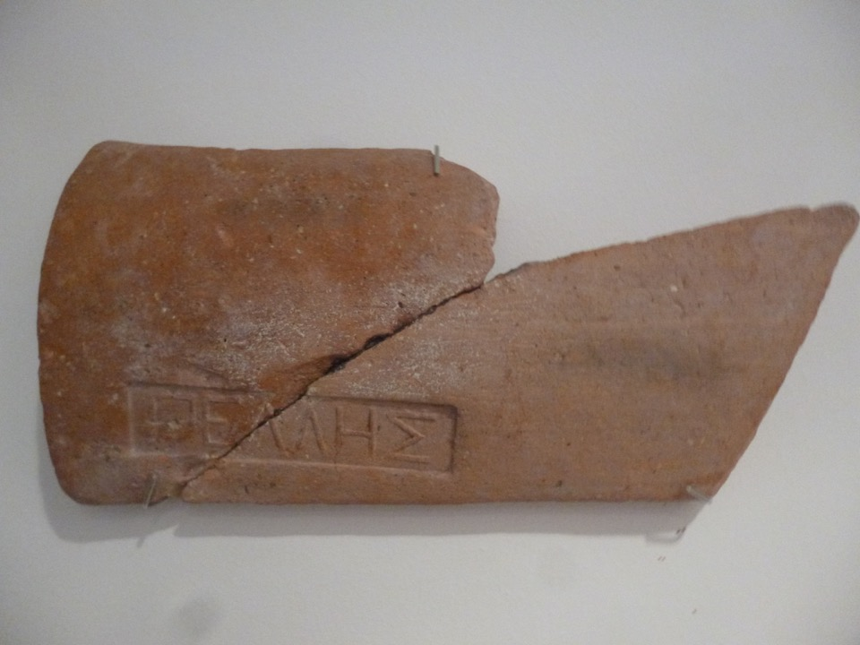
Stamped roof tiles bearing the inscription
‘of Pella’

Slide 21
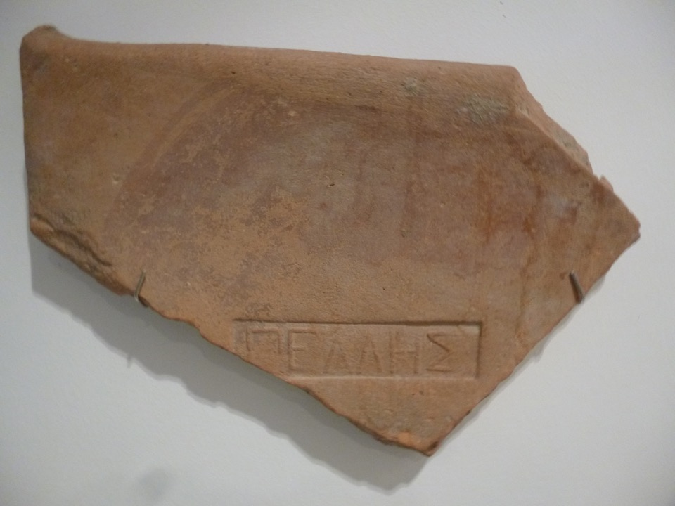

Slide 22
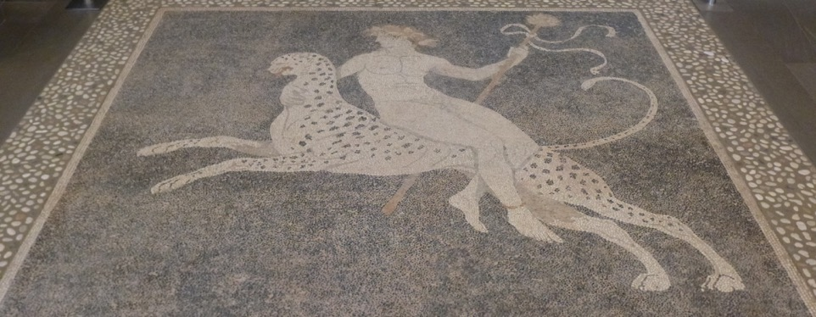

Slide 23
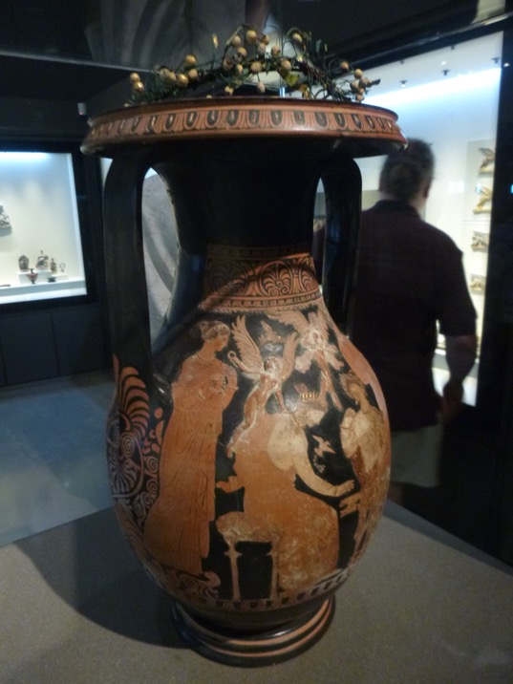

Slide 24
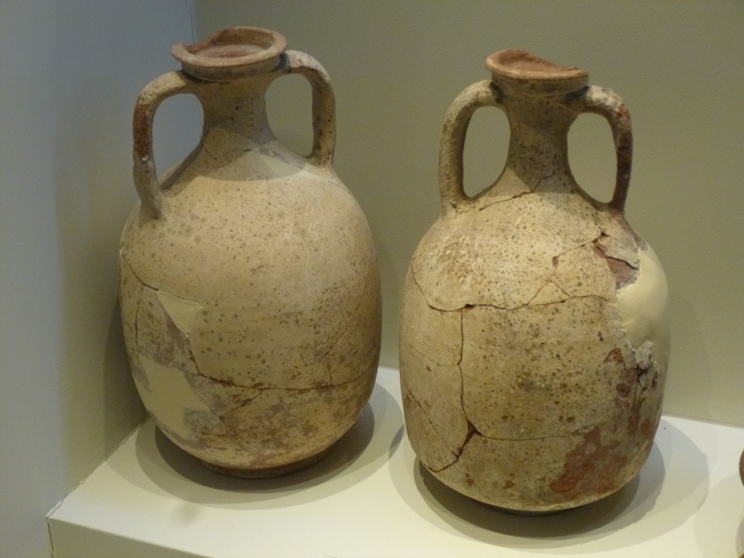

Slide 25
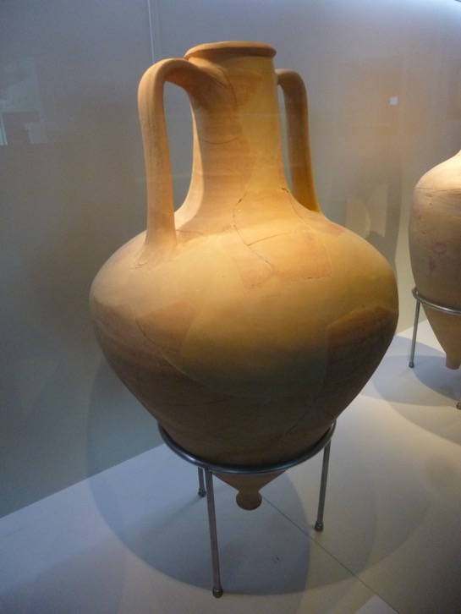
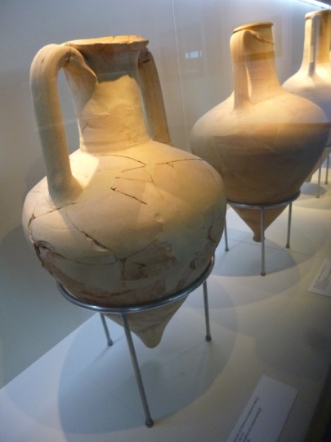
End 4th – early 3rd c BC

Slide 26
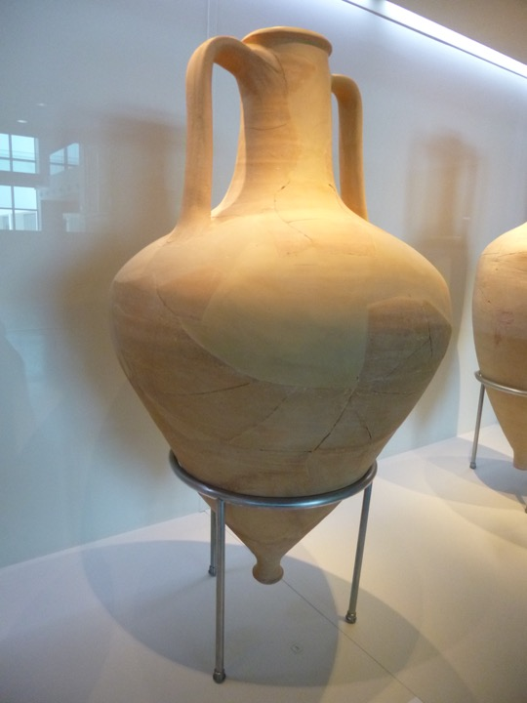
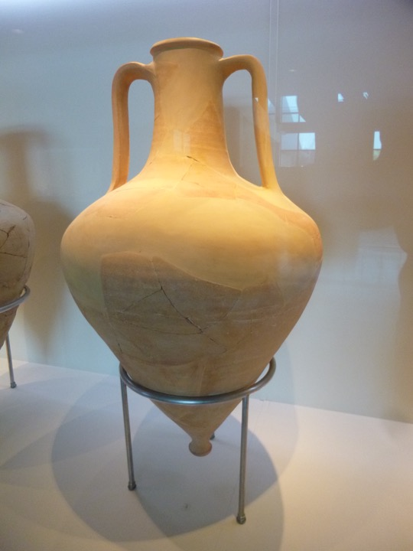

Slide 27
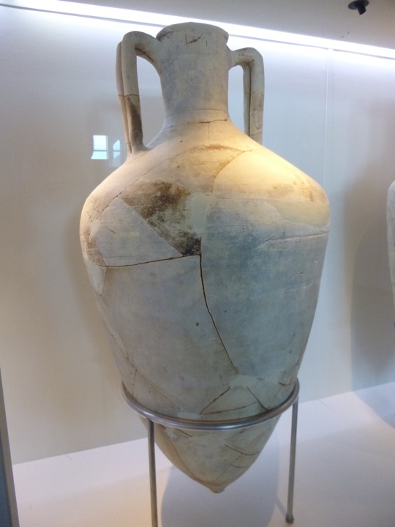
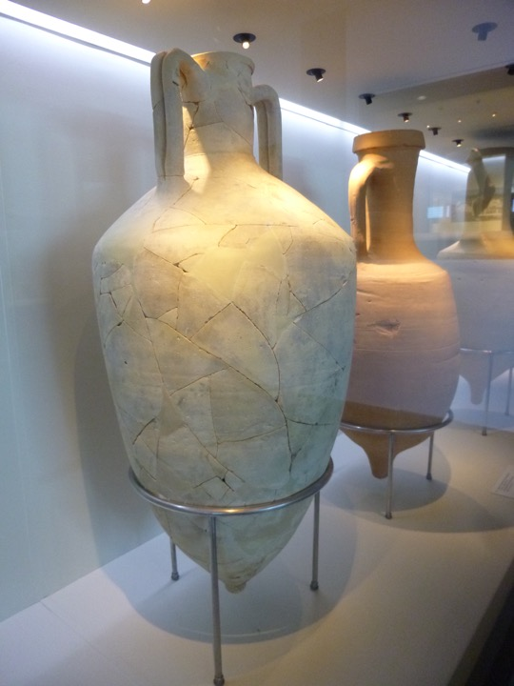
End 2nd – early 1st c BC

Slide 28
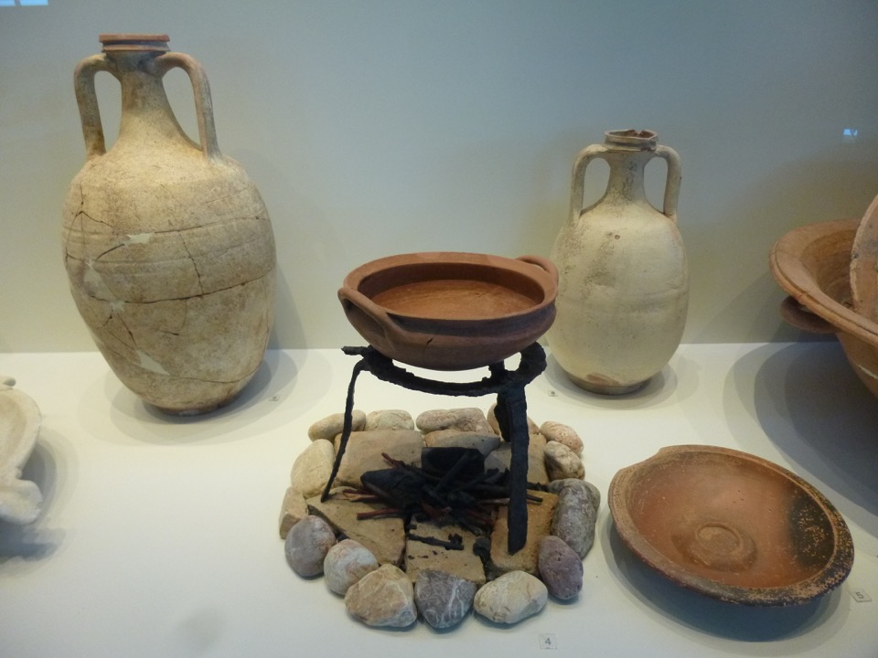
Every day dishes & utensils from an ancient house
Late 4th – early 1st c BC

Slide 29
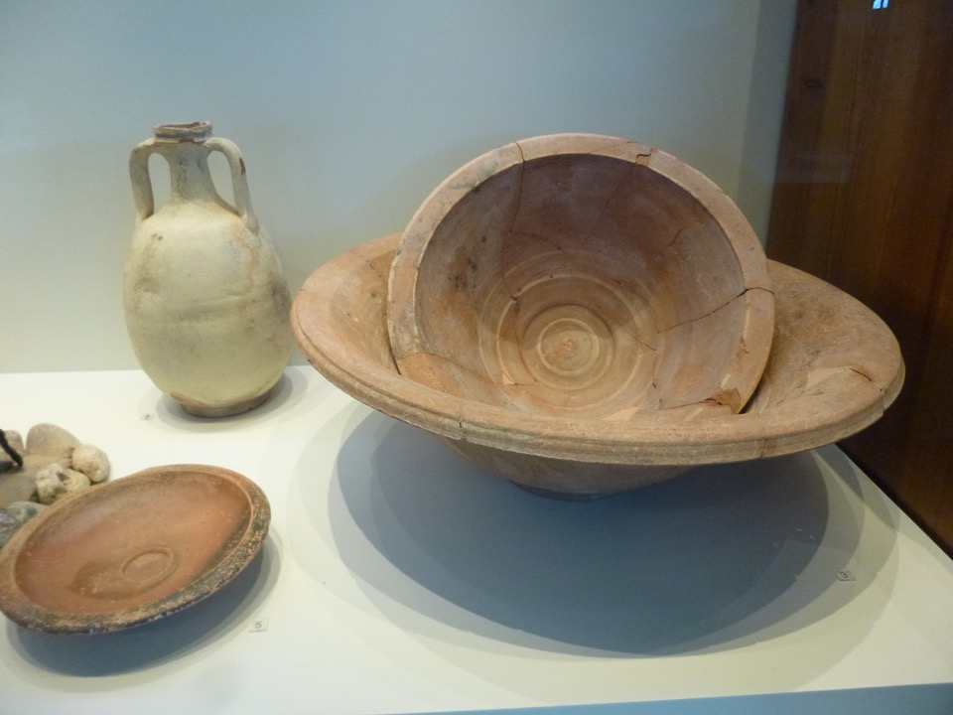
Every day dishes & utensils from an ancient house
Late 4th – early 1st c BC

Slide 30
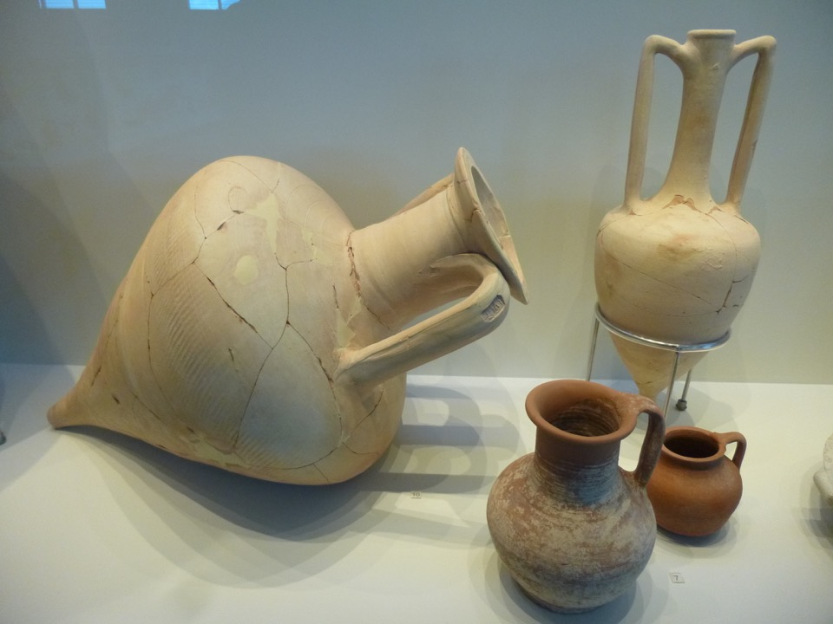
Every day dishes & utensils from an ancient house
Late 4th – early 1st c BC

Slide 31
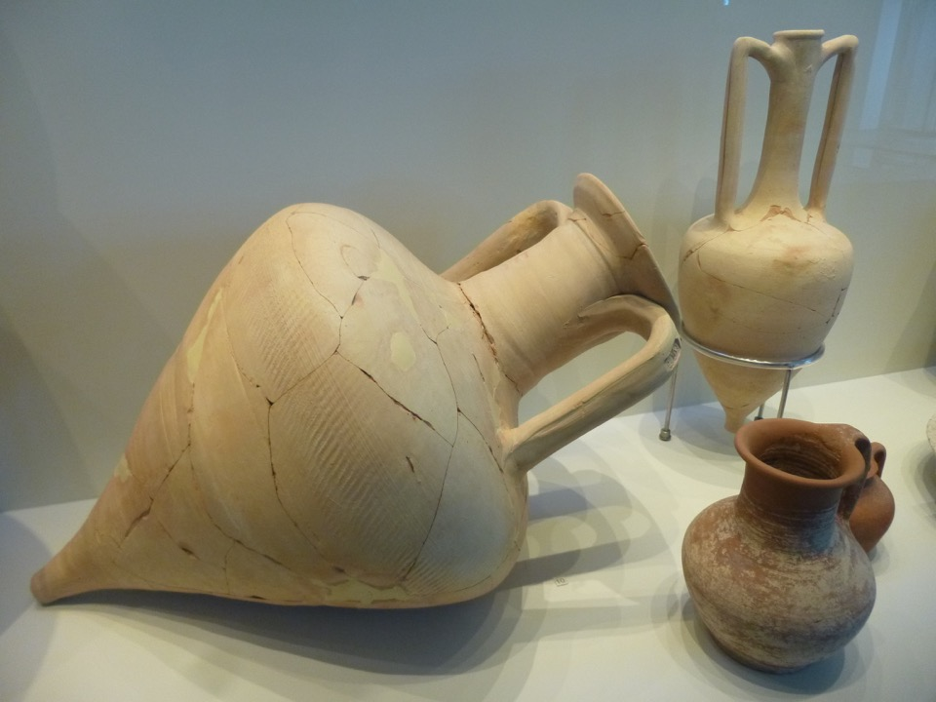
Every day dishes & utensils from an ancient house
Late 4th – early 1st c BC

Slide 32
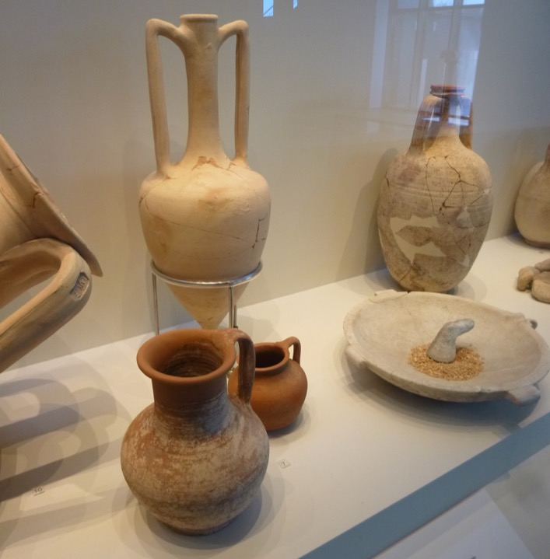
Every day dishes & utensils from an ancient house
Late 4th – early 1st c BC

Slide 33
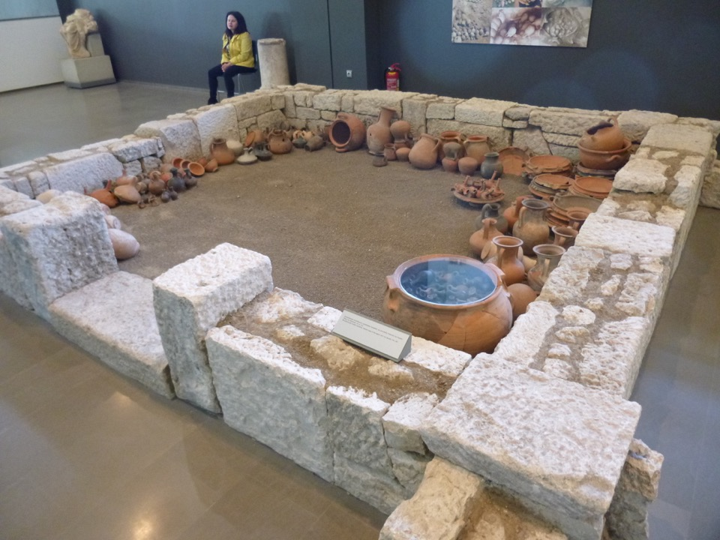
Reconstructed ceramic workshop – east wing of agora
Early 1st c BC

Slide 34
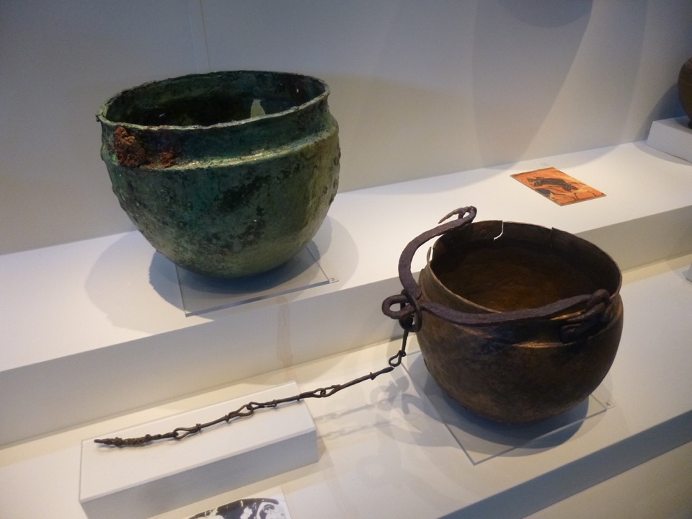
Vessels from the well in the agora
3rd c BC

Slide 35
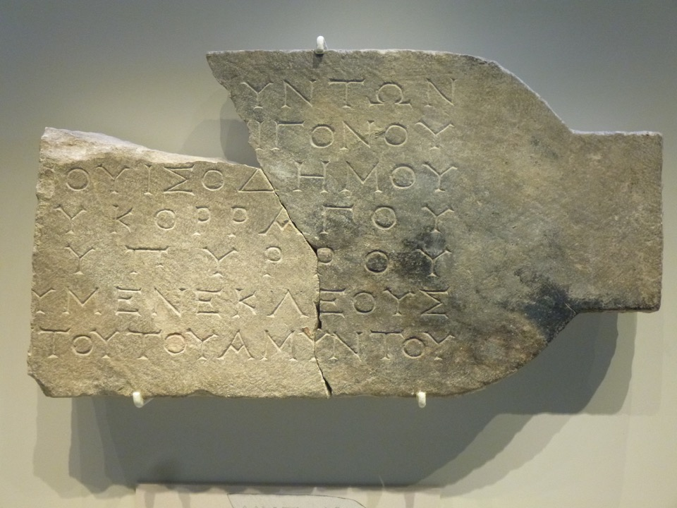
From the public archives
inscription bearing names of six politicians
2nd c BC

Slide 36
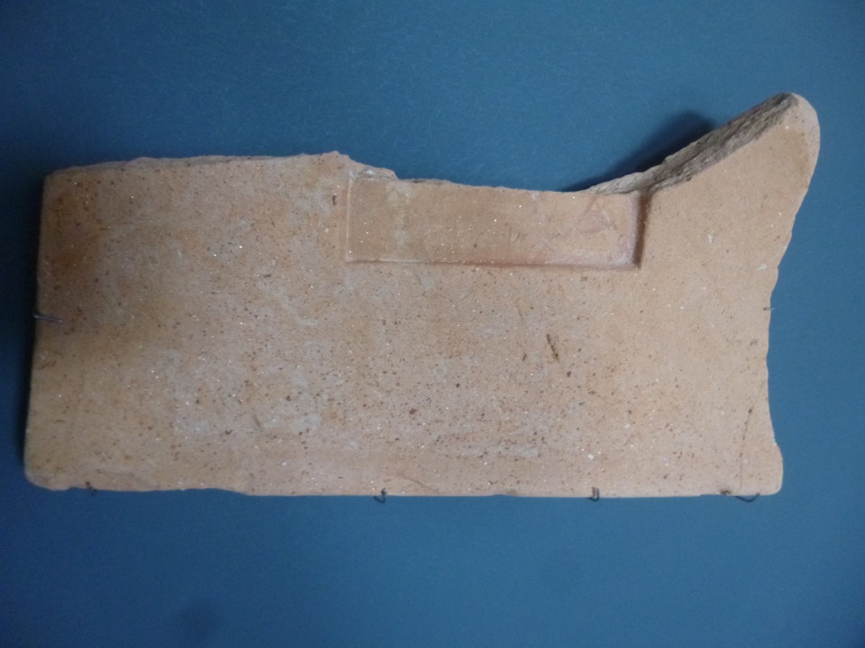
Tiles from palace of Pella bearing the inscriptions
‘royal’ and ‘of Lysimachus’
(3rd-2nd c BC)

Slide 37
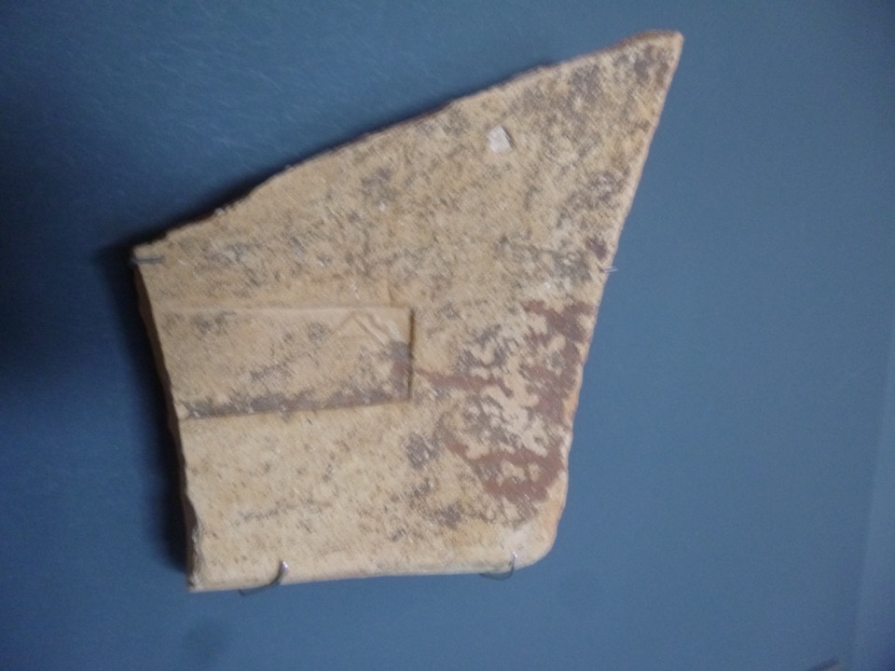

Slide 38
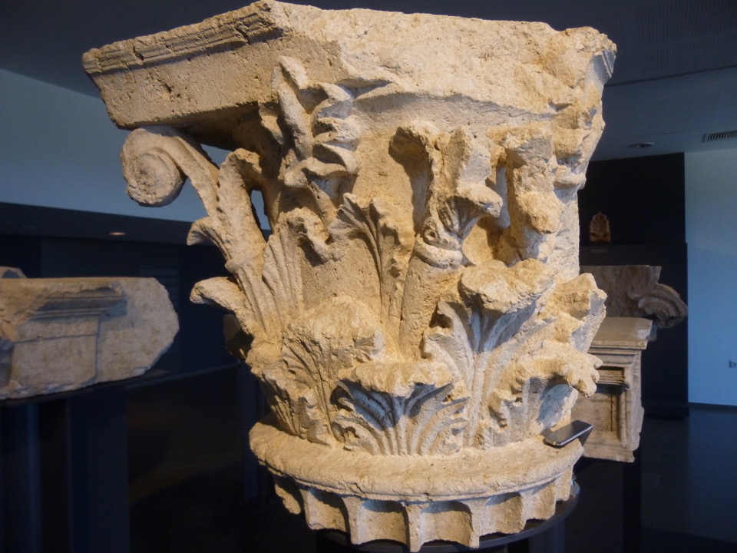
Corinthian pilaster
from the youth palaestra (wrestling) school

Slide 39
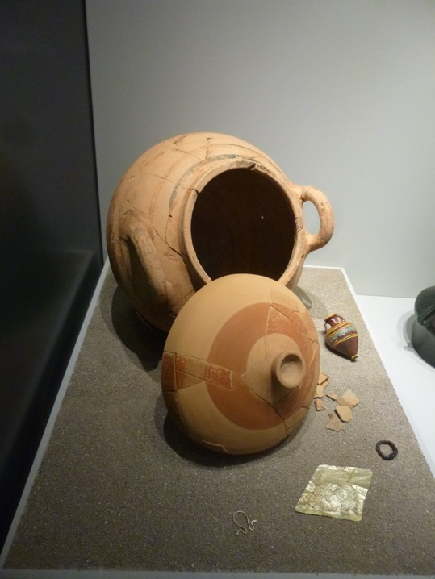
Palace Items
Female burial items – ash-container, gold mouthpiece, silver earrings (480-450 BC)

Slide 40
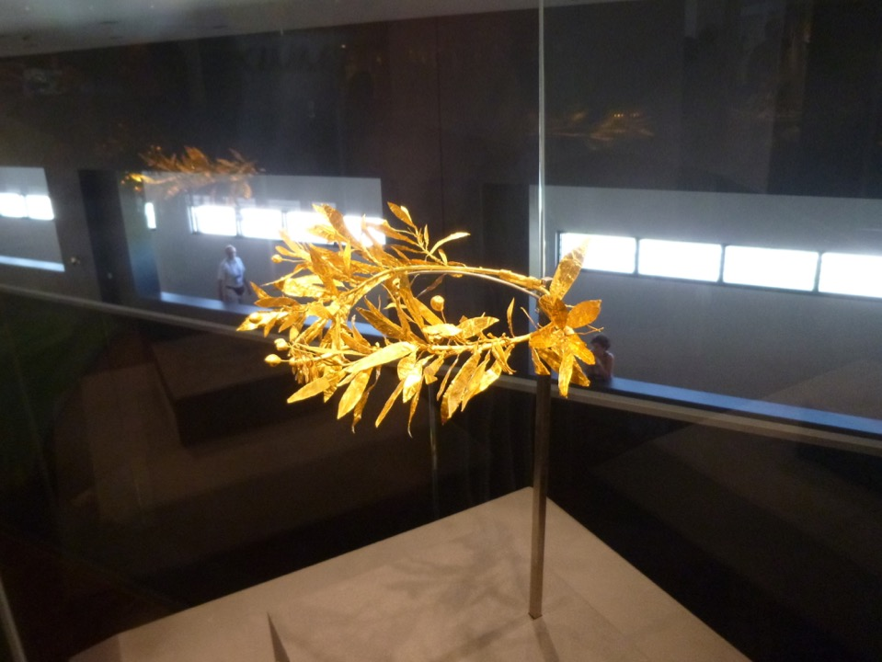
Gold myrtle wreath
(325-300 BC)

Slide 41
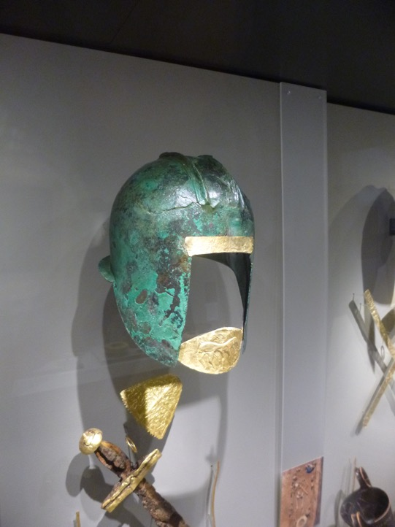
Male burial items – helmet, gold mouthpiece, iron sword (about 530 BC)

Slide 42
Burial items from the 3rd millennium BC

Slide 43
Infant burial in a vessels
(2200-1800 BC)
(6500-5800 BC)

