Slide 1
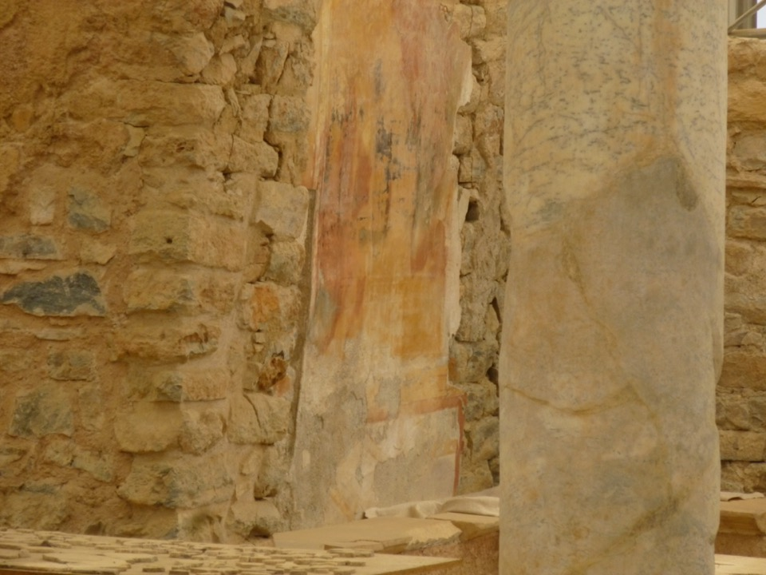
Ephesus
Apartment Houses

Slide 2
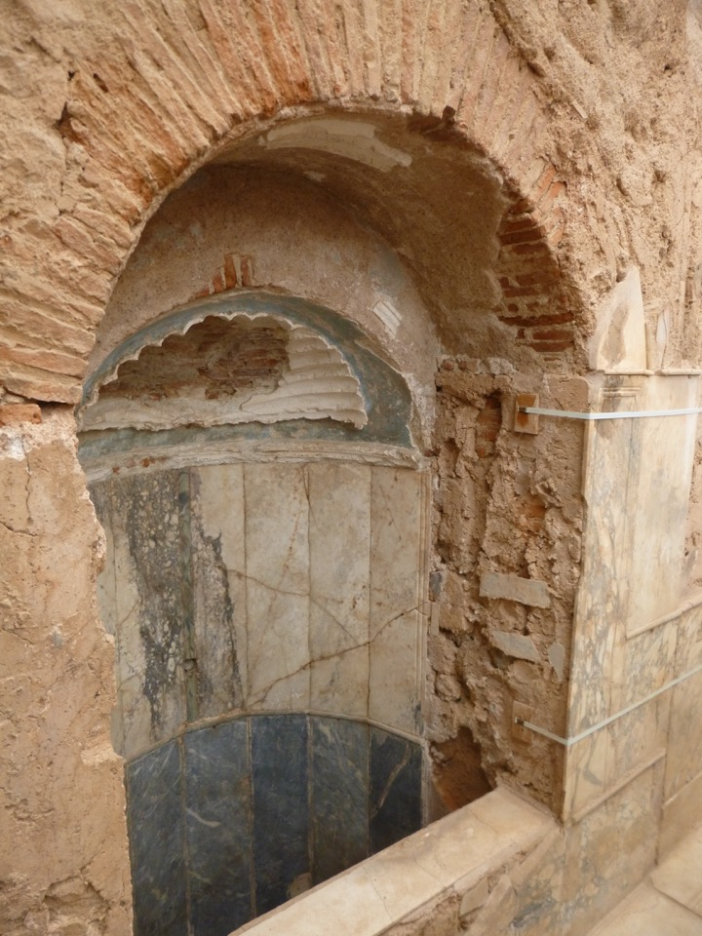

Slide 3
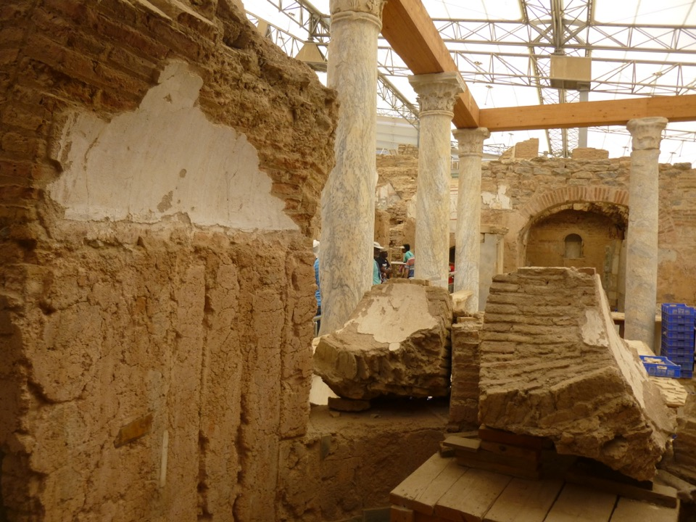

Slide 4
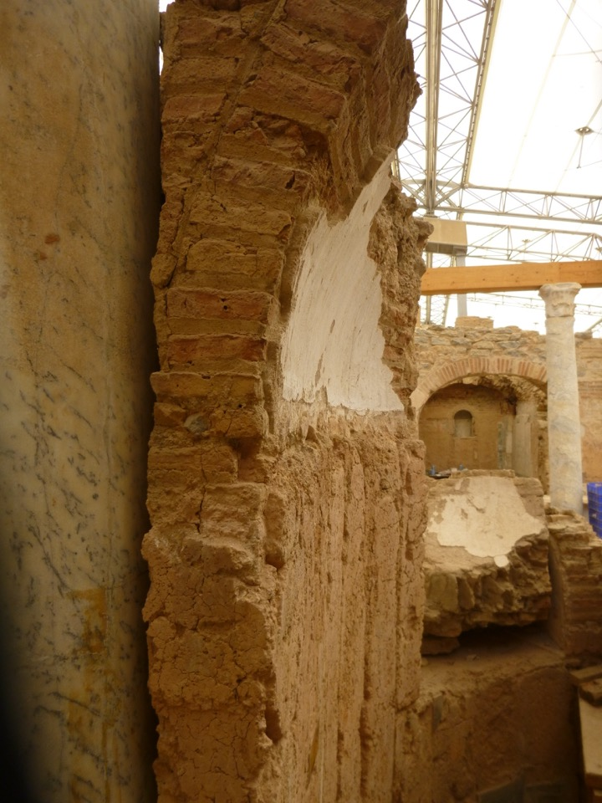

Slide 5
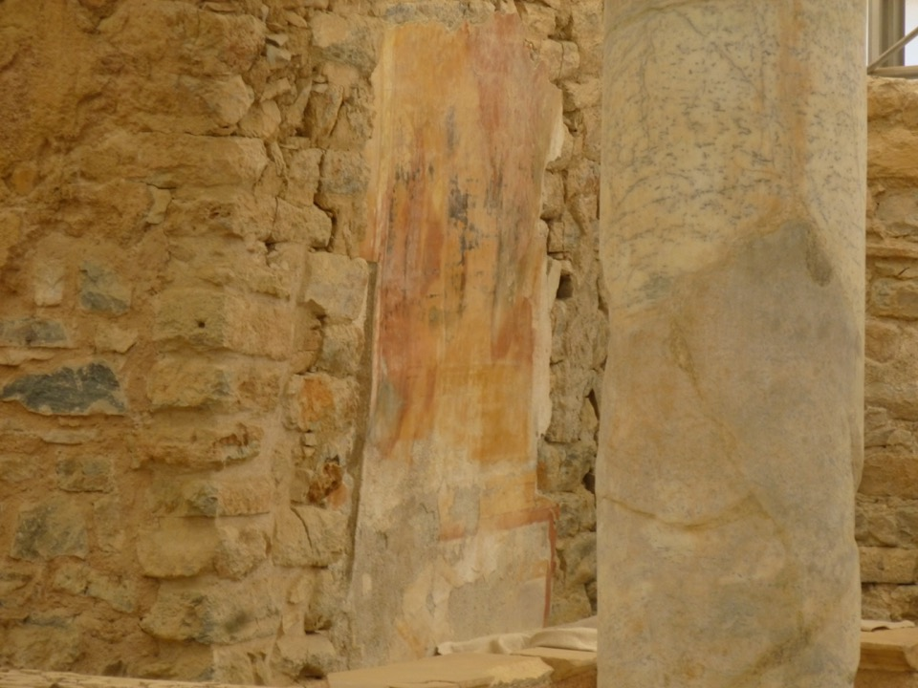
Private bath – dwelling 6
(heated floors, walls, basins in marbles; windows attired with glass)

Slide 6
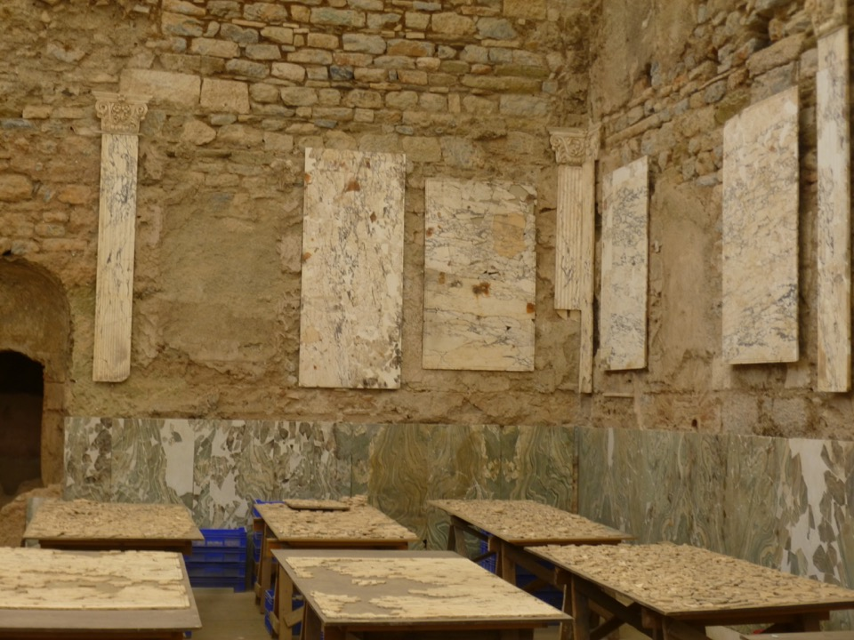
Dwelling unit 6
(Marble hall – in use after destruction of 262 AD)

Slide 7
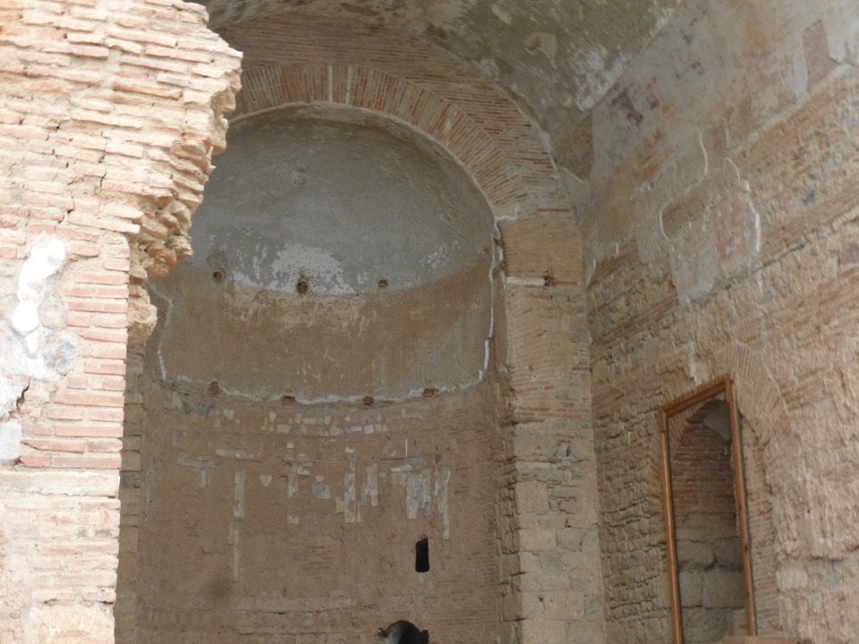
Dwelling unit 6
(basilica built around 160 AD)

Slide 8
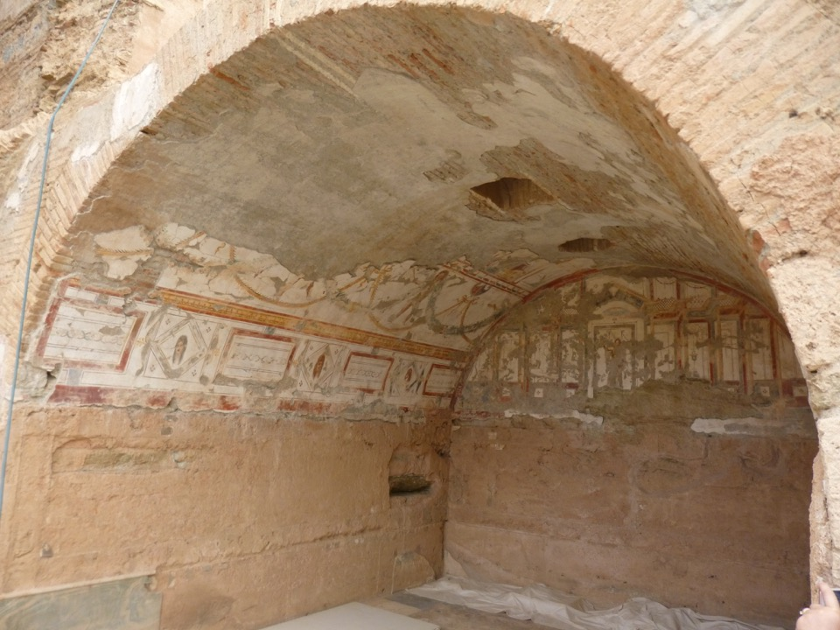

Slide 9
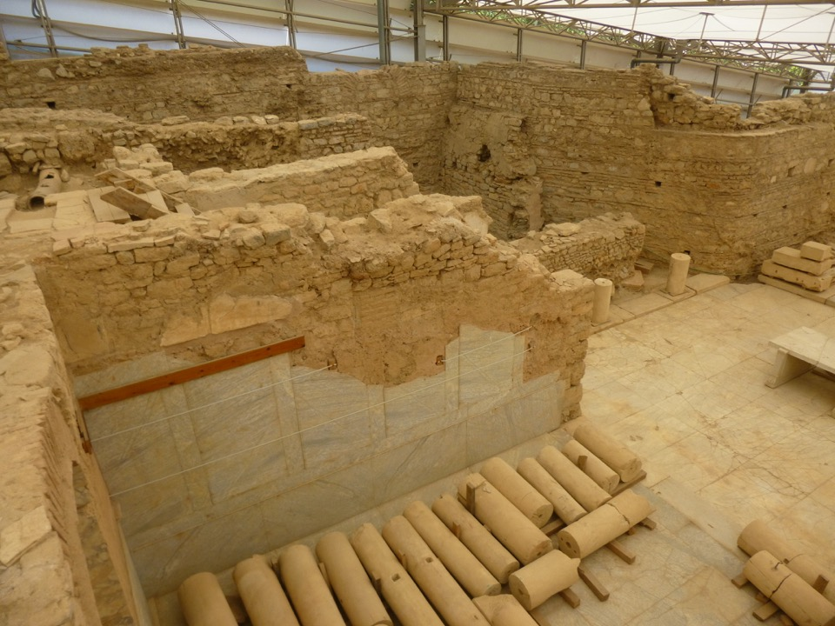

Slide 10
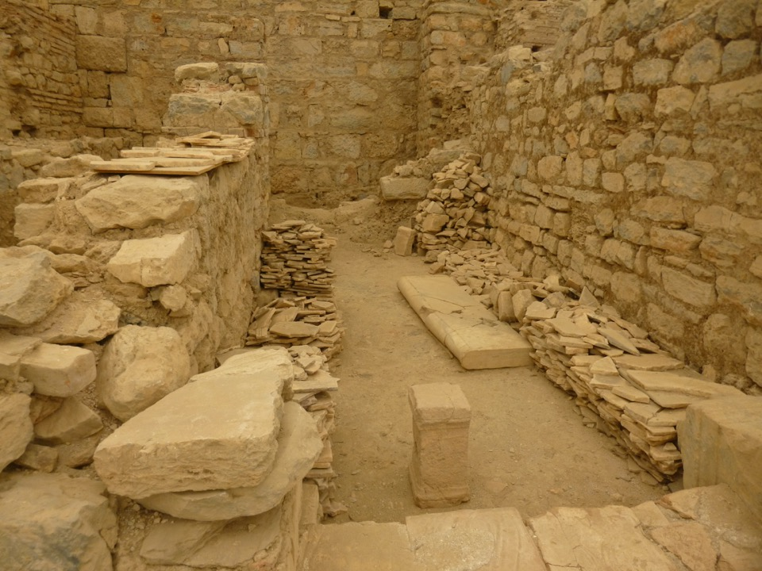
Hellenistic Structures
(6-4th C BC this area was used as a graveyard
- terraced houses built here in 1st C BC)

Slide 11
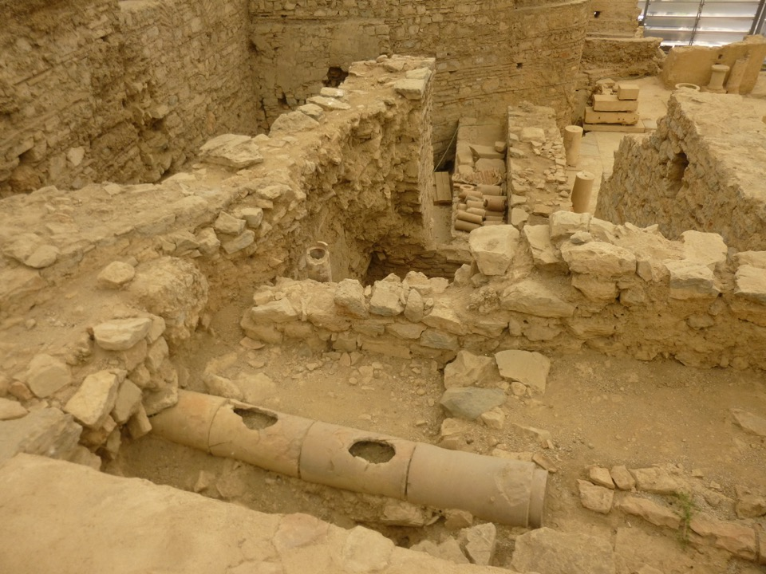
Dwelling unit 7
(Byzantine buildings over 3rd C AD structures)

Slide 12
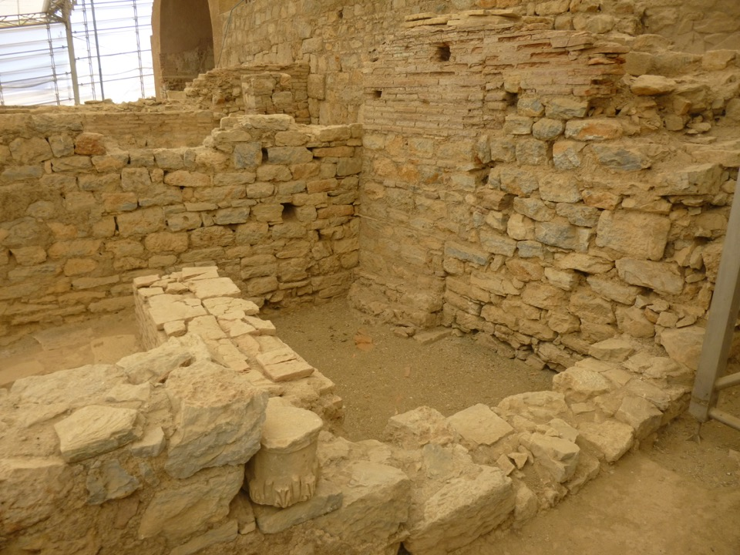
Terrace House 2

Slide 13
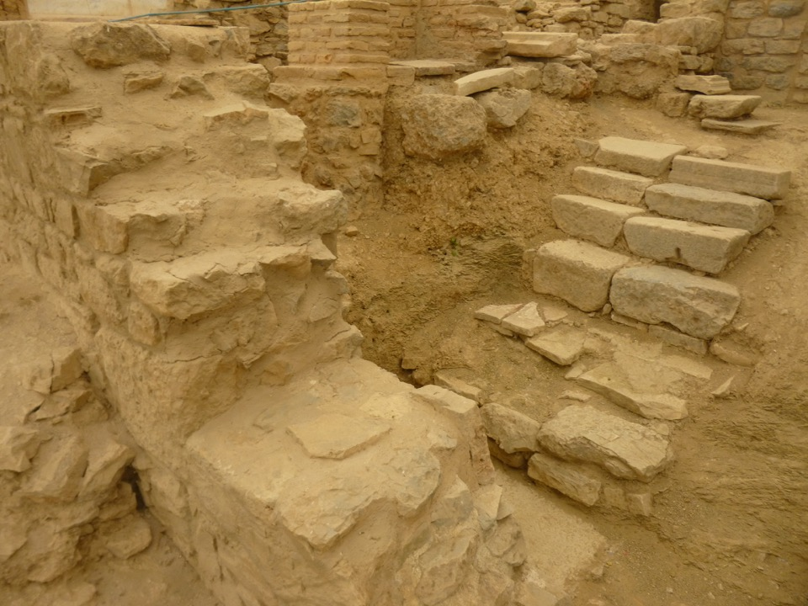

Slide 14
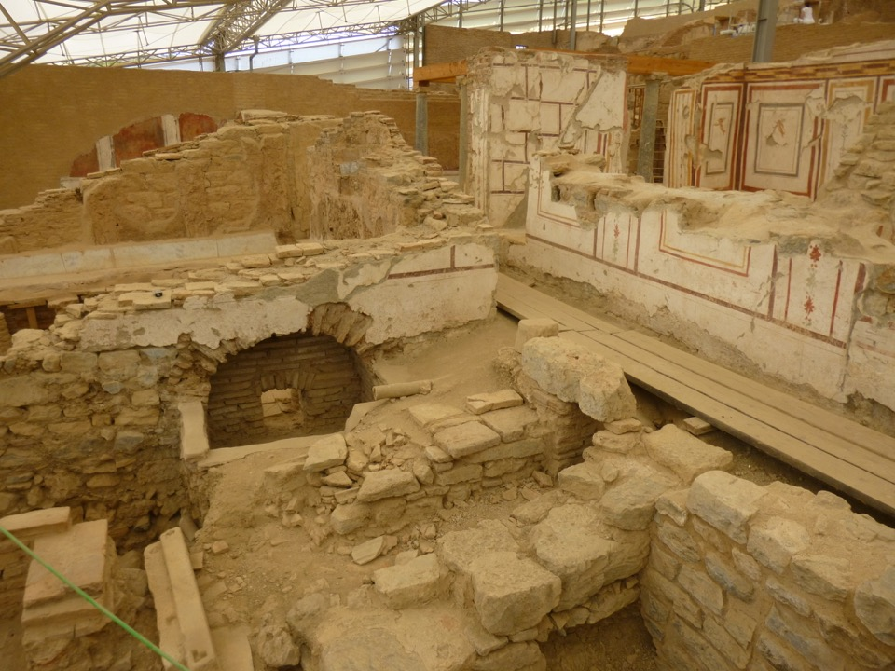
Dwelling units 3 & 5

Slide 15
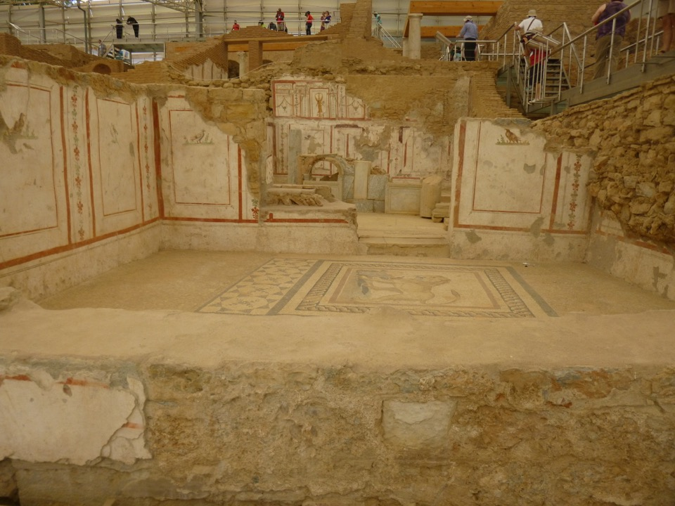

Slide 16
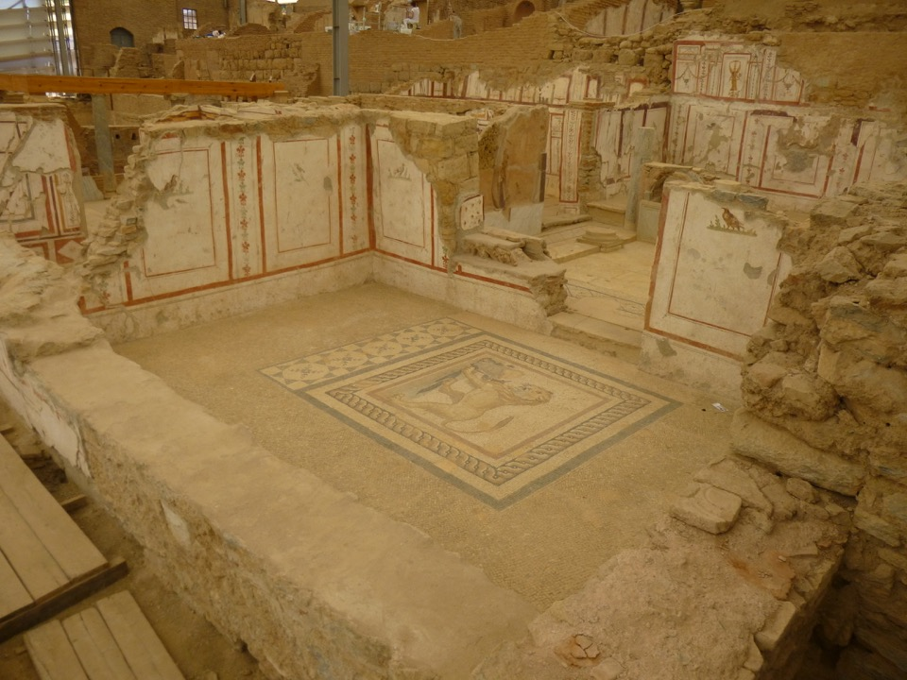

Slide 17
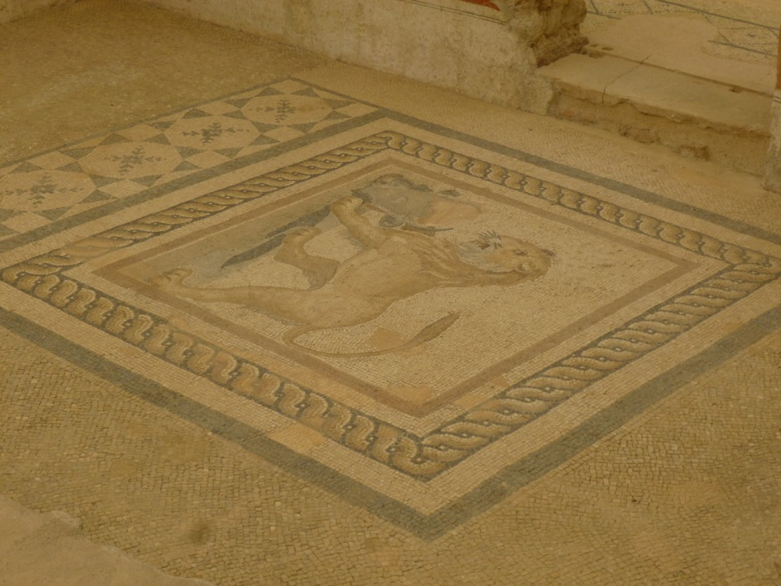

Slide 18
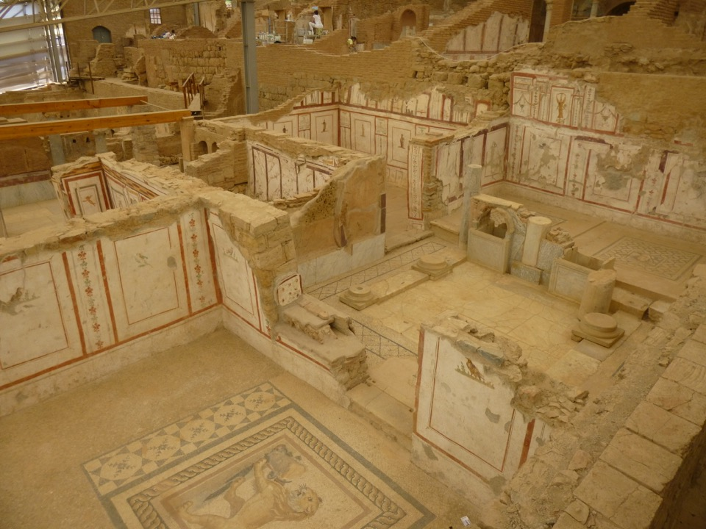

Slide 19
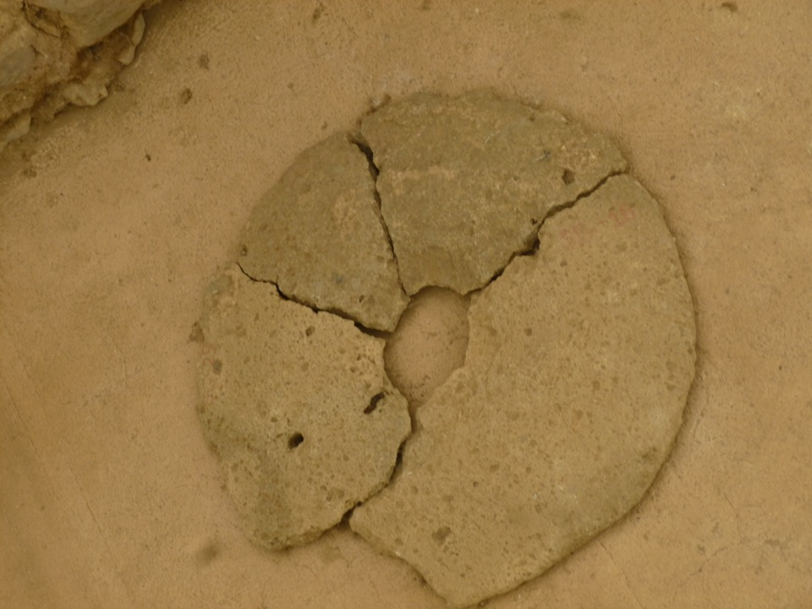
Handicraft quarter on western side of Terrace House 2
Byzantine 7th C AD
(several mills, potteries & stone processing factories)

Slide 20
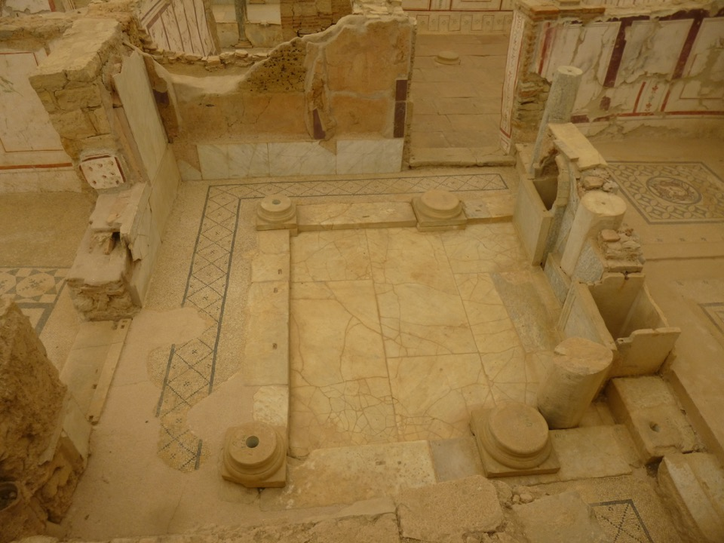

Slide 21
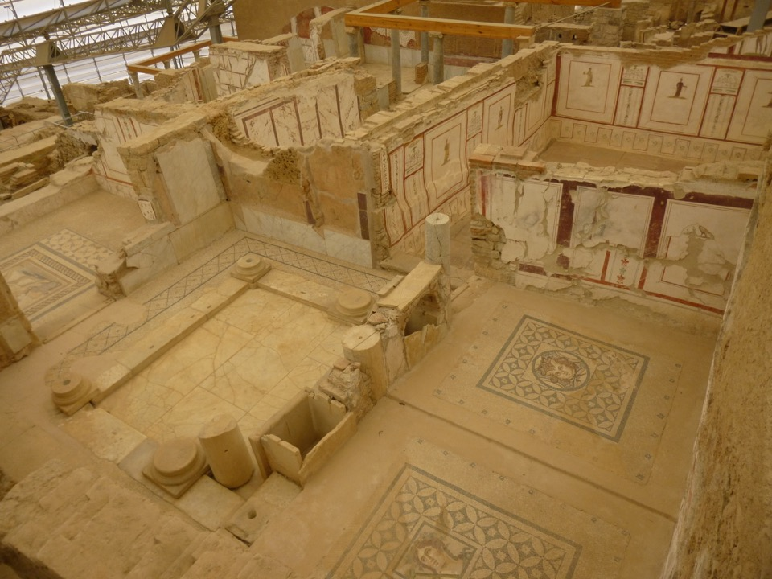

Slide 22
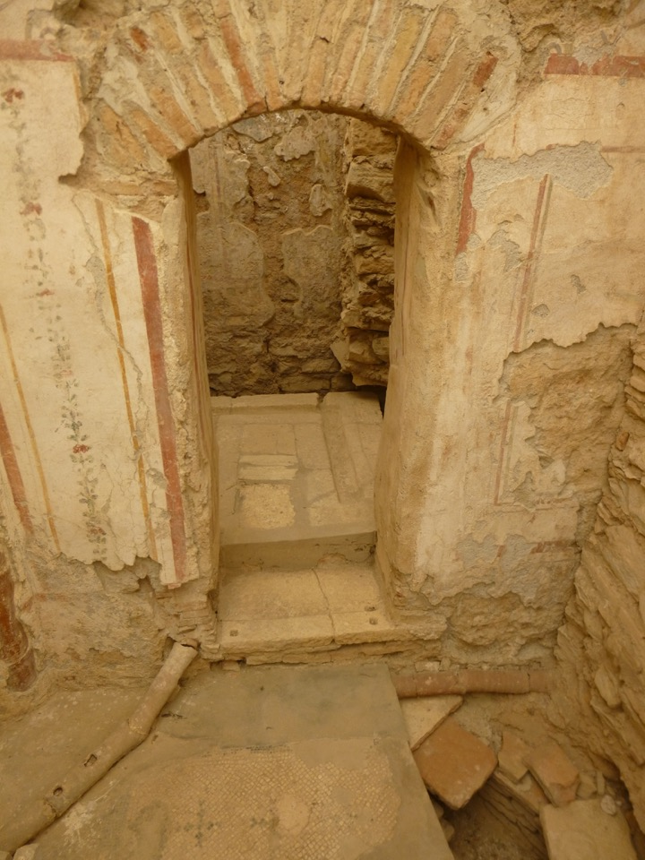
Dwelling Unit 2 - lattrine

Slide 23
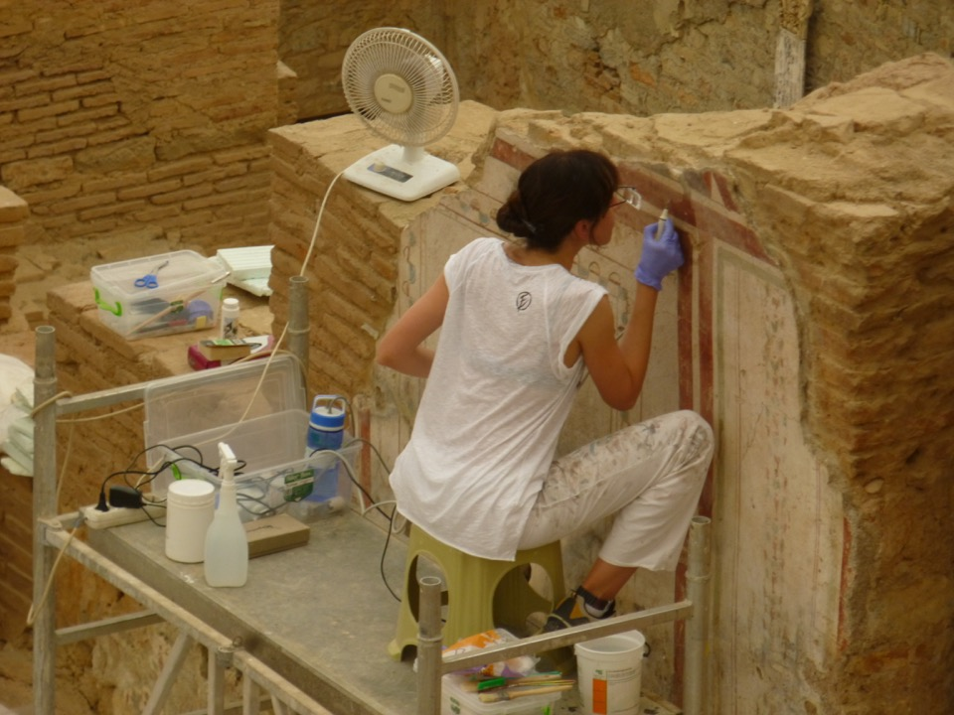
Restoration work continues

Slide 24
